Slide 1
UCSD Embedded C Assignment 6
By
Hsuankai Chang
hsuankac@umich.edu

Slide 2
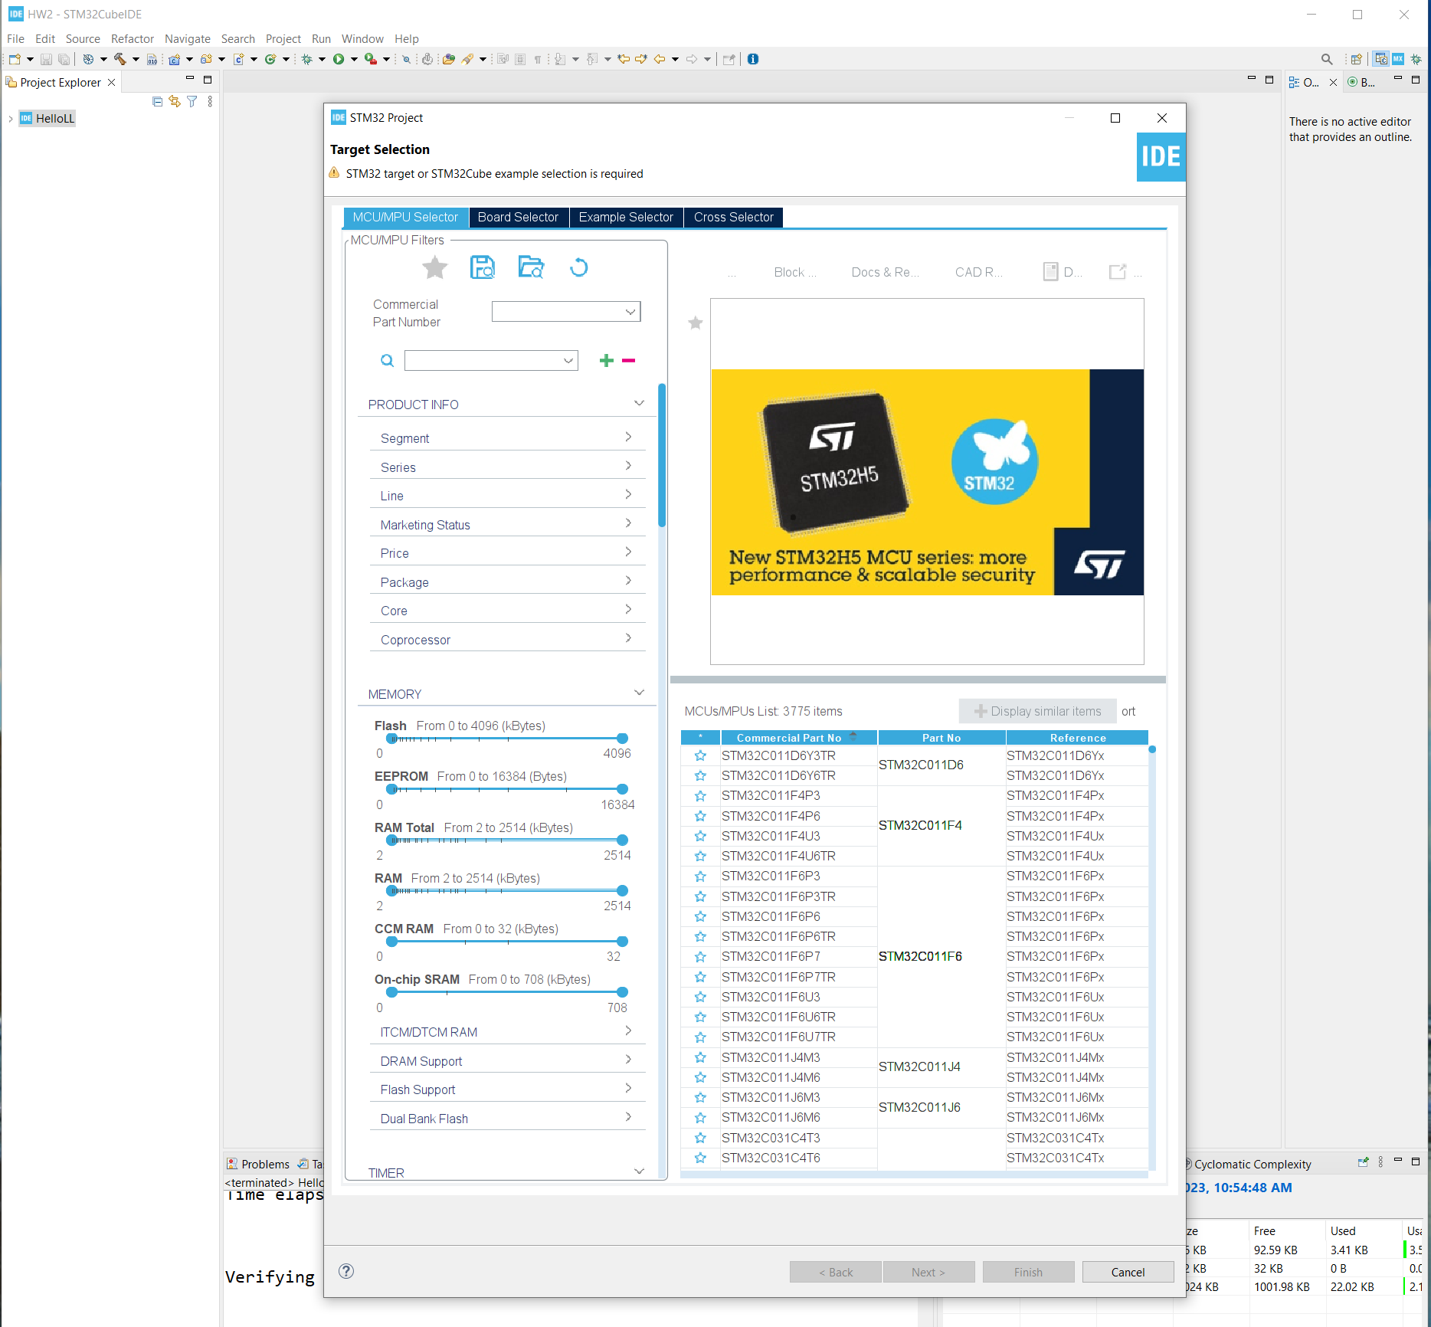
Step 1. Startup STM32CubeIDE and create new STM32 project

Slide 3
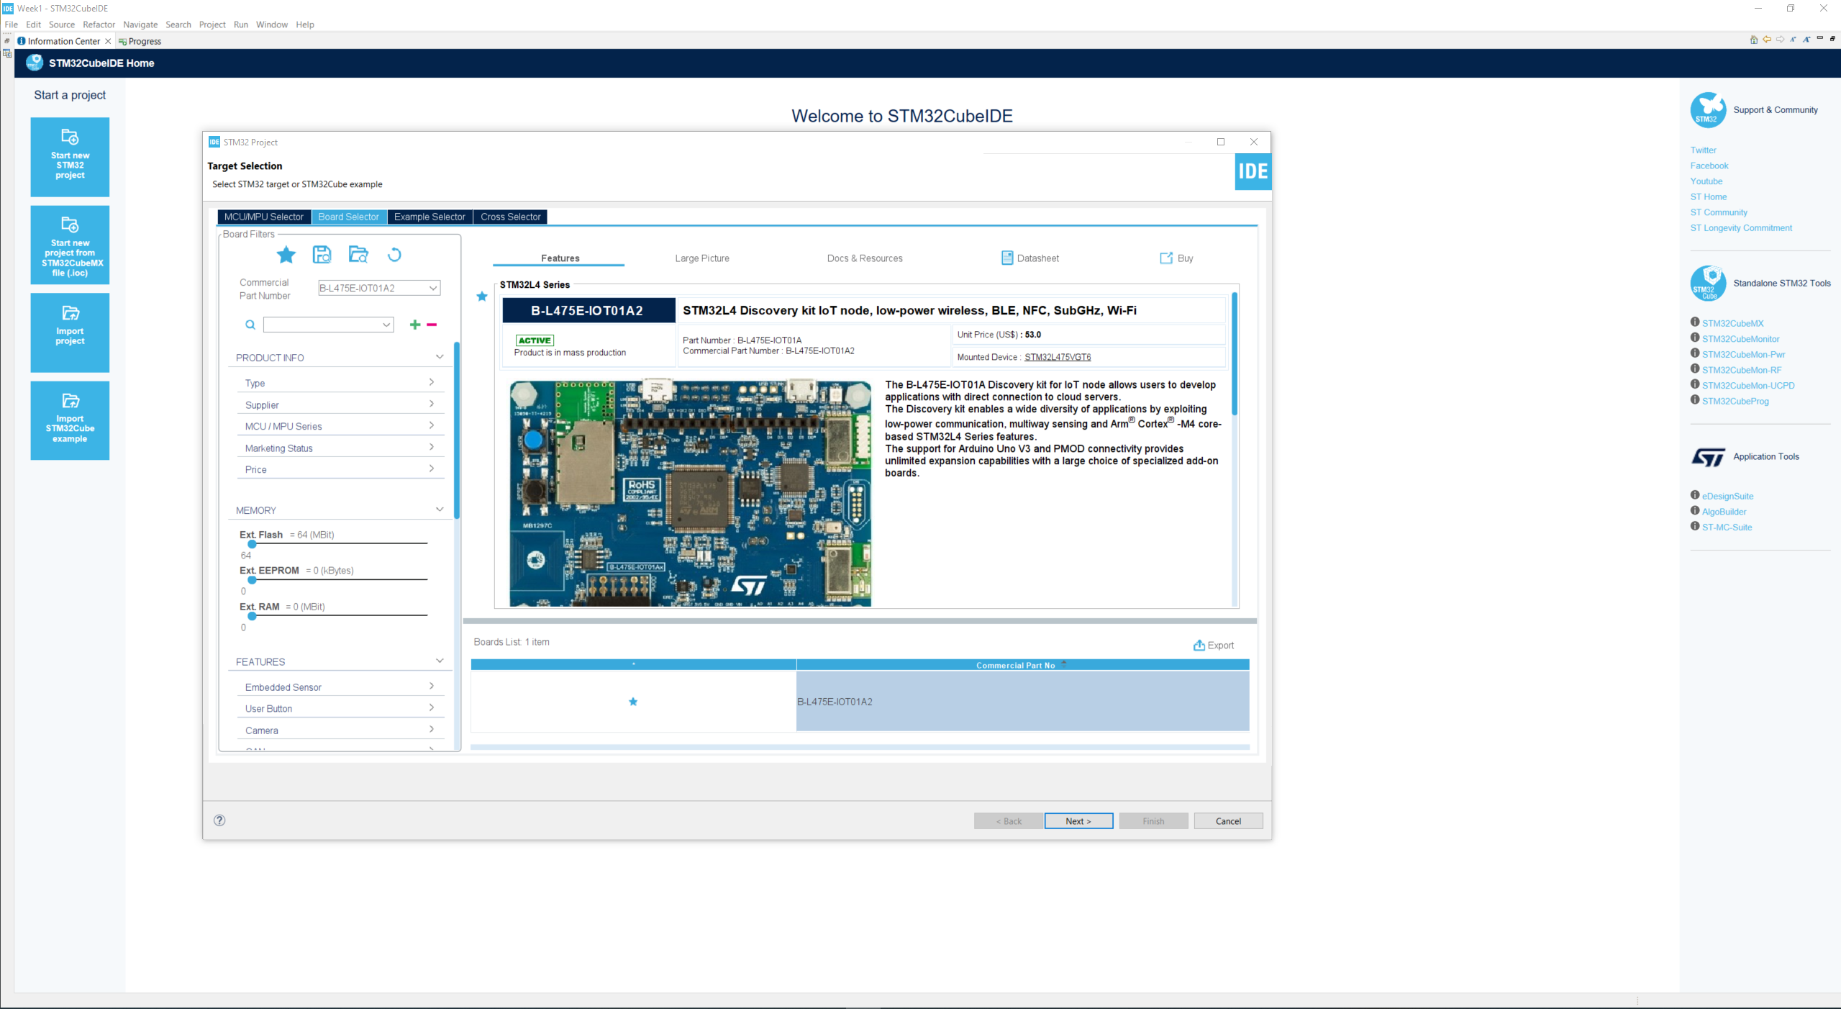
Step 2. Access board selector and type in the board you use, click Next

Slide 4
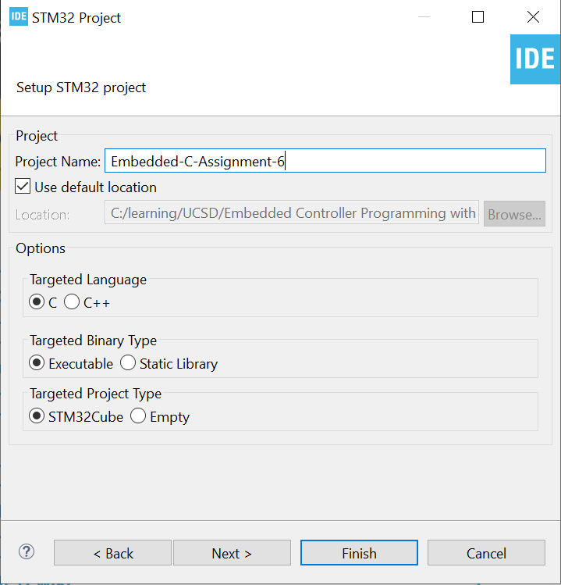
Step 3. Enter the project name then click Next

Slide 5
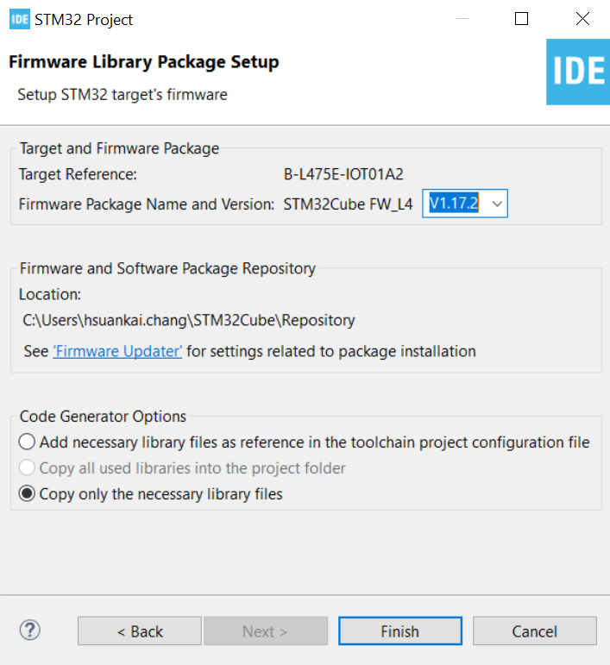
Step 4. See the firmware package name and version

Slide 6
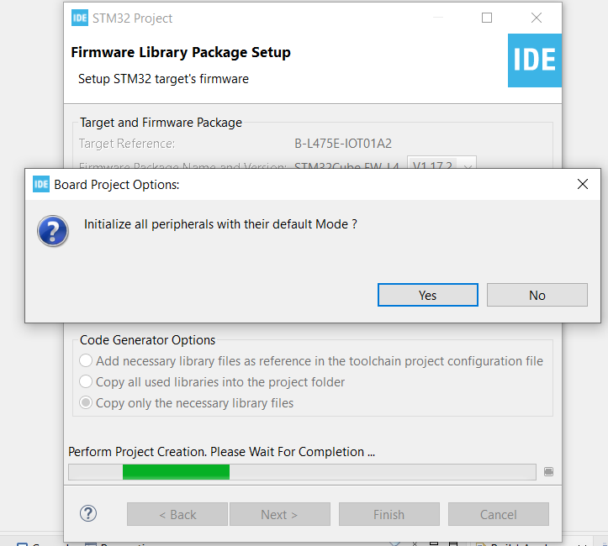
Step 5. Click yes to initialize all peripherals to default

Slide 7
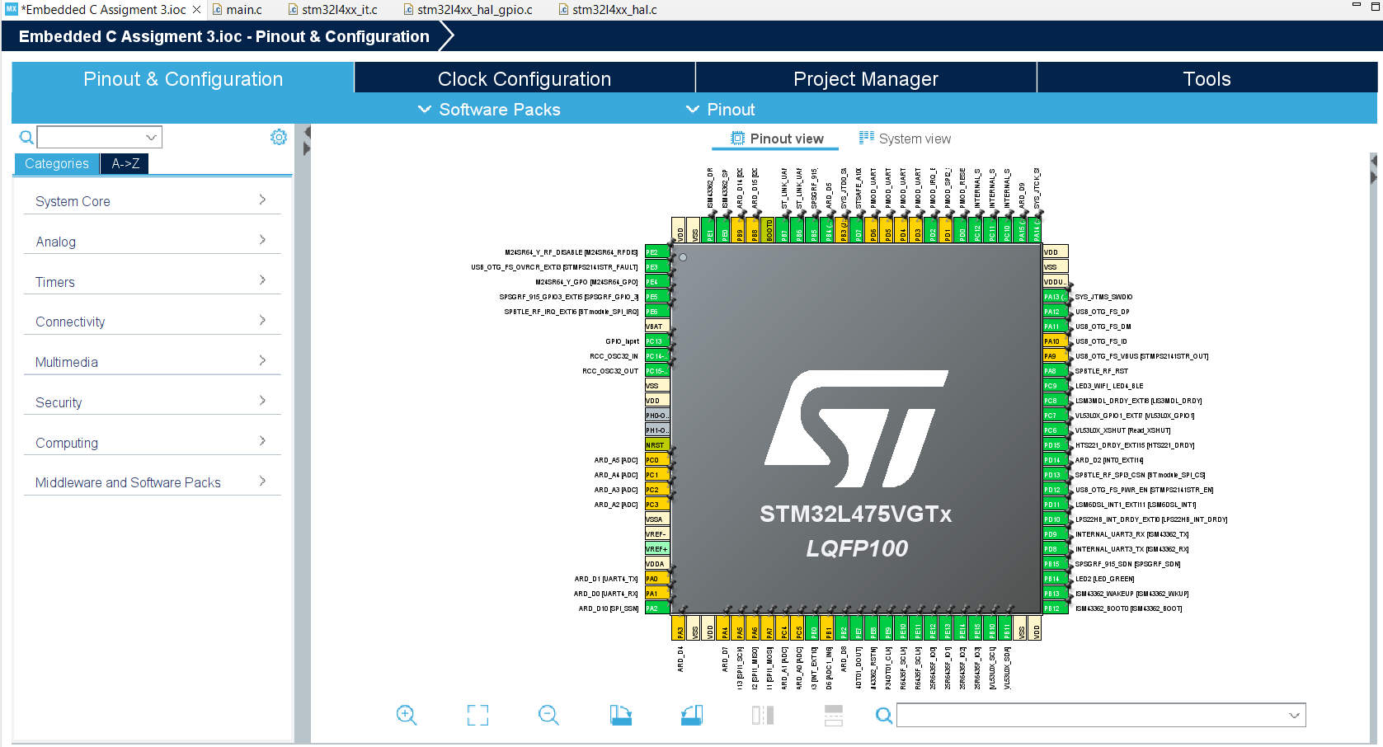
Step 6. When in .ioc file, click Pinout & Configurations

Slide 8
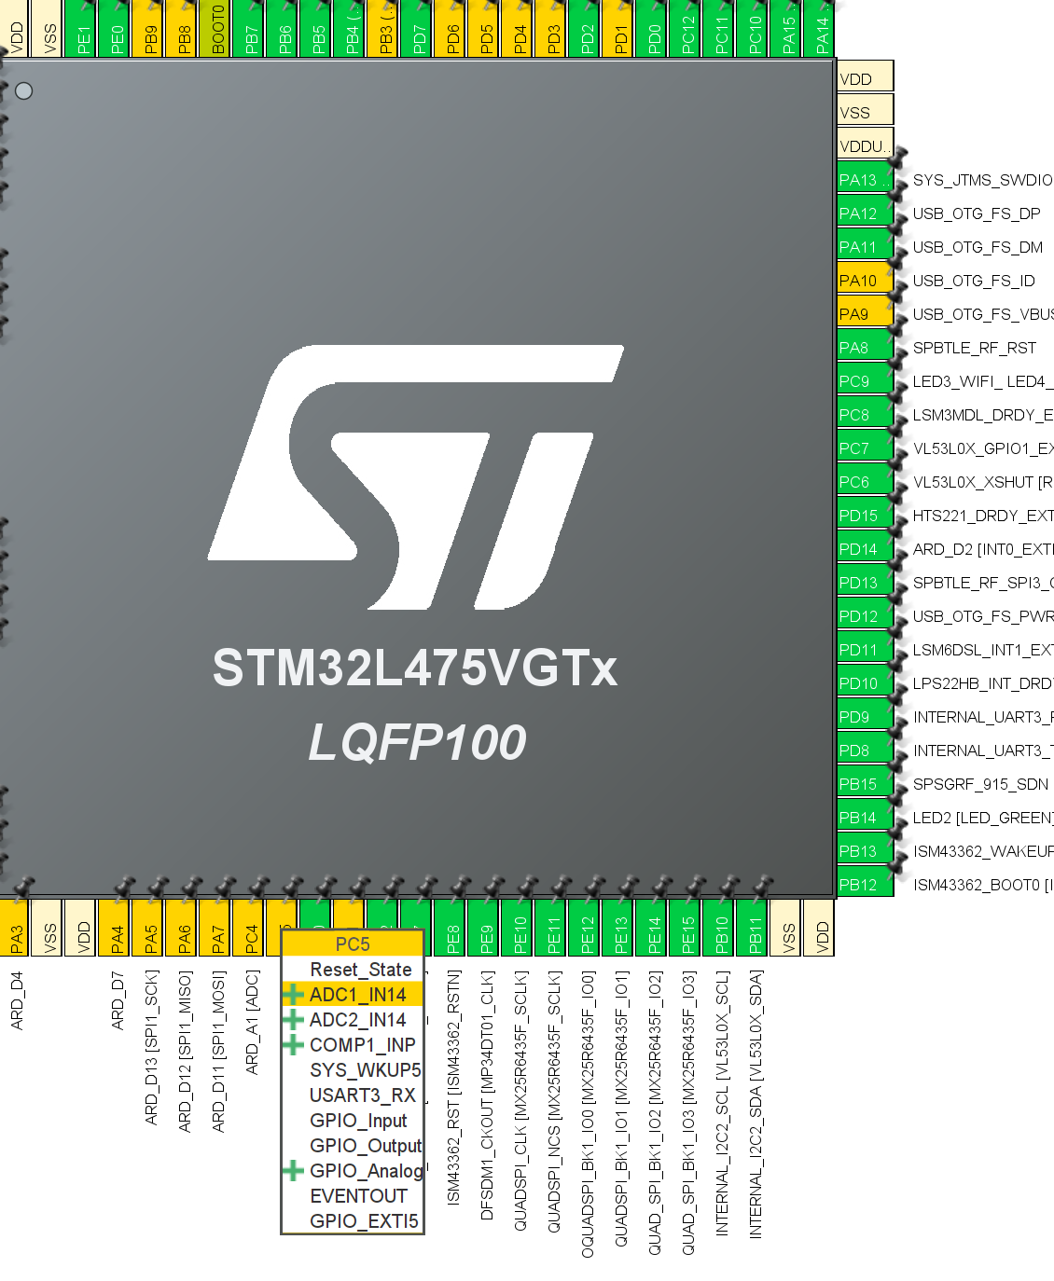
Step 7. Observe PC5 -> ADC1_IN14 -> ADR_A0

Slide 9
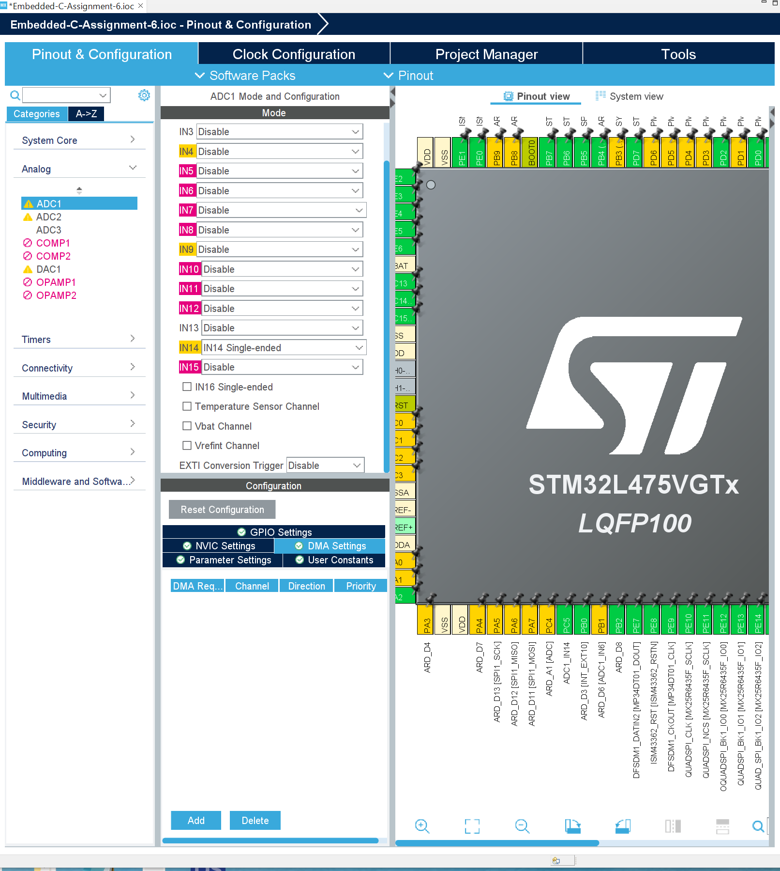
Step 8. Set ADC1, IN14 to Single-ended

Slide 10
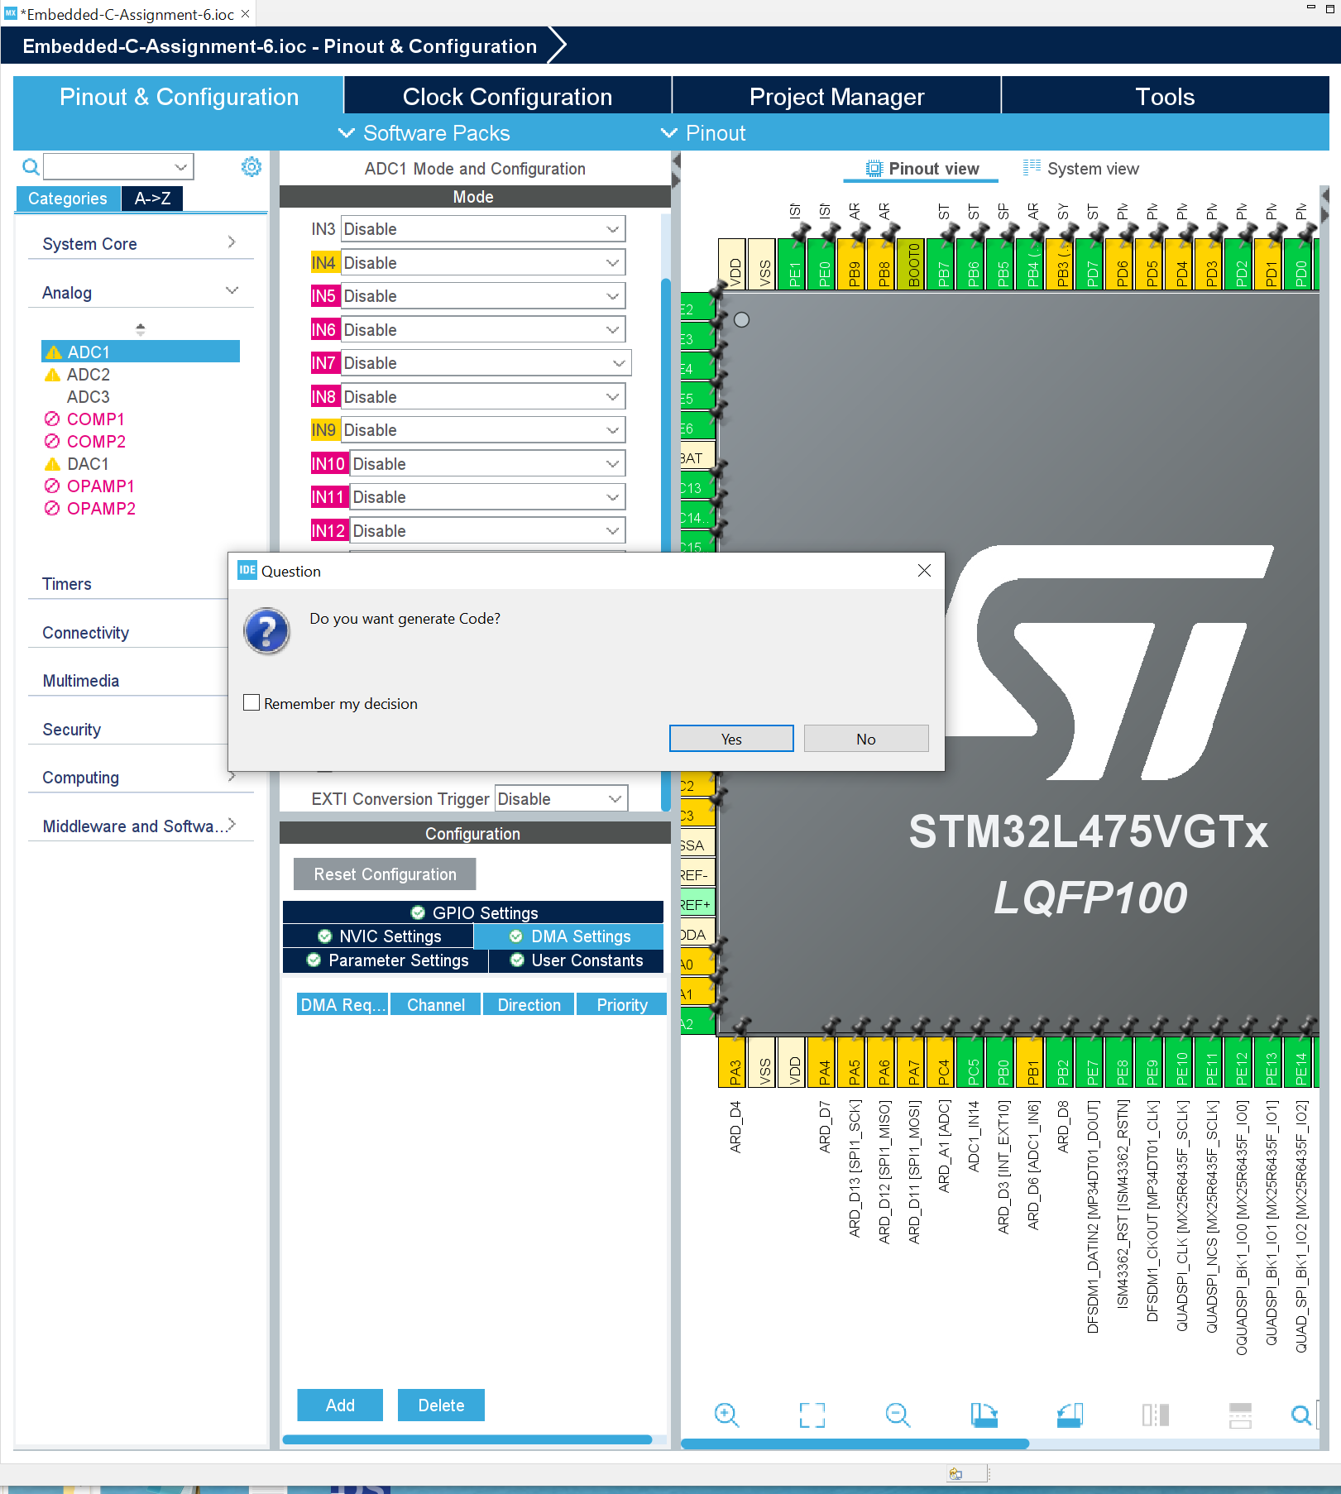
Step 9. Generate code

Slide 11
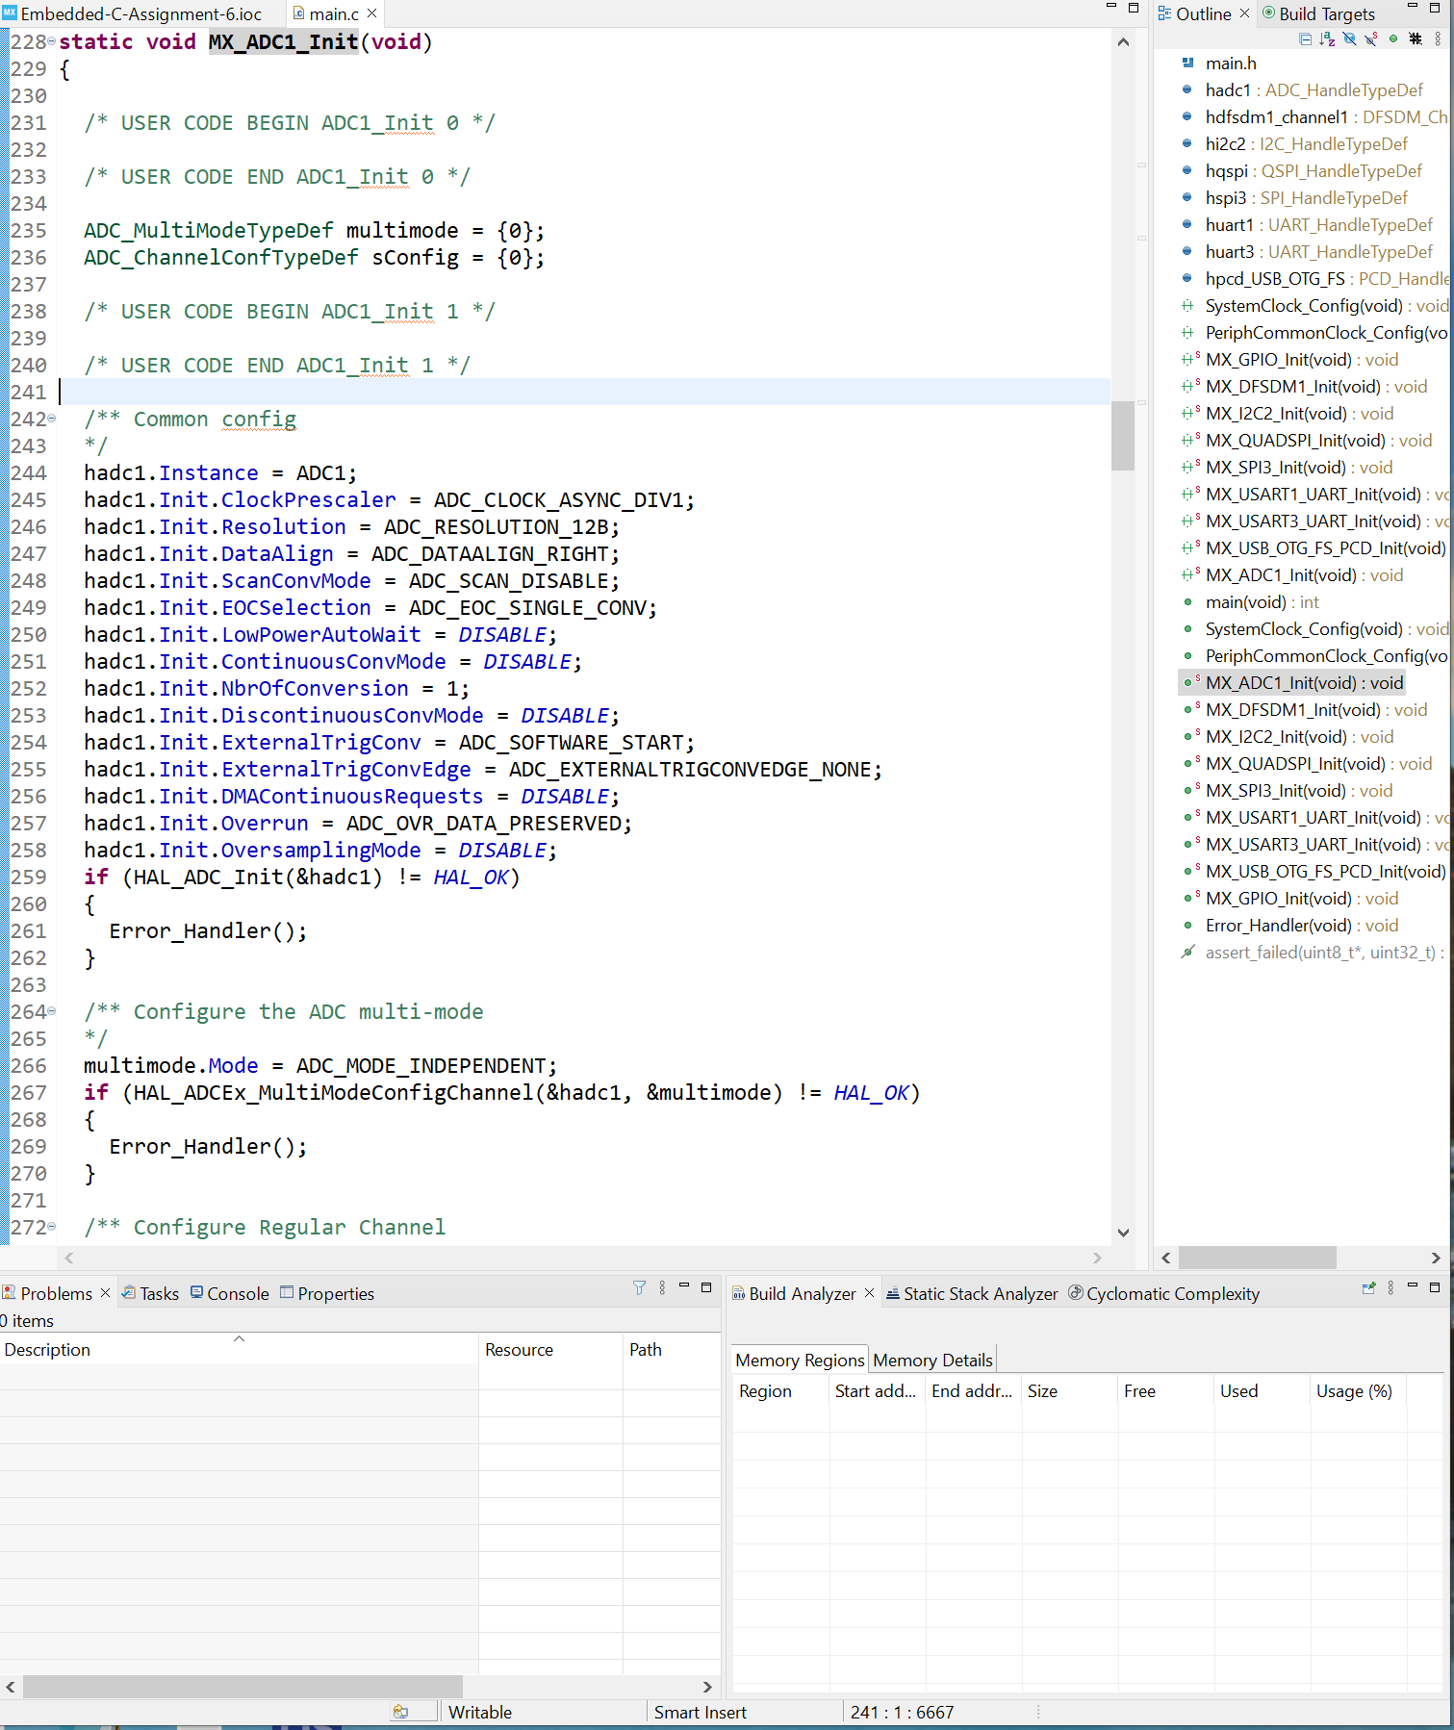
Step 10. In main.c, find code that initializes the ADC1

Slide 12
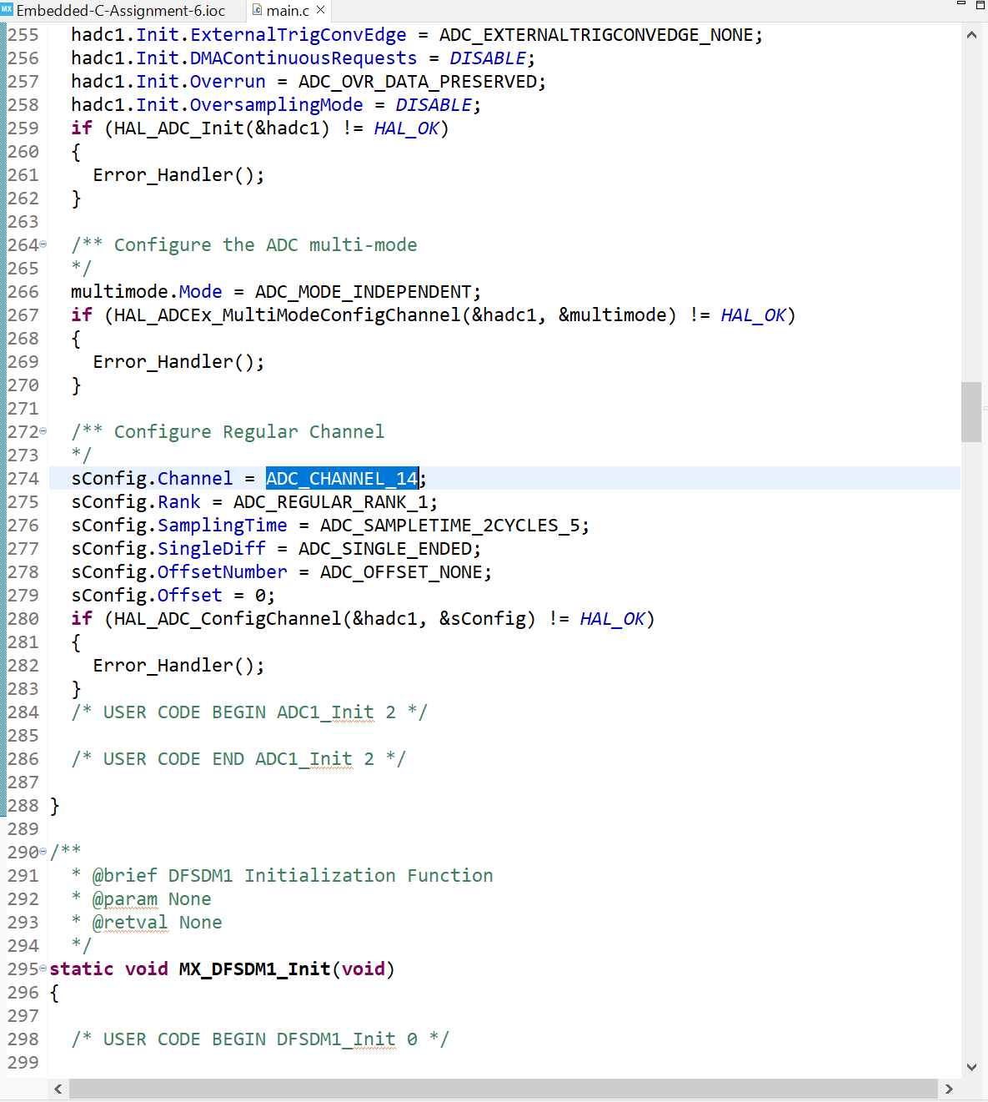
Step 11. In main.c, find code that initialize the channel IN14

Slide 13
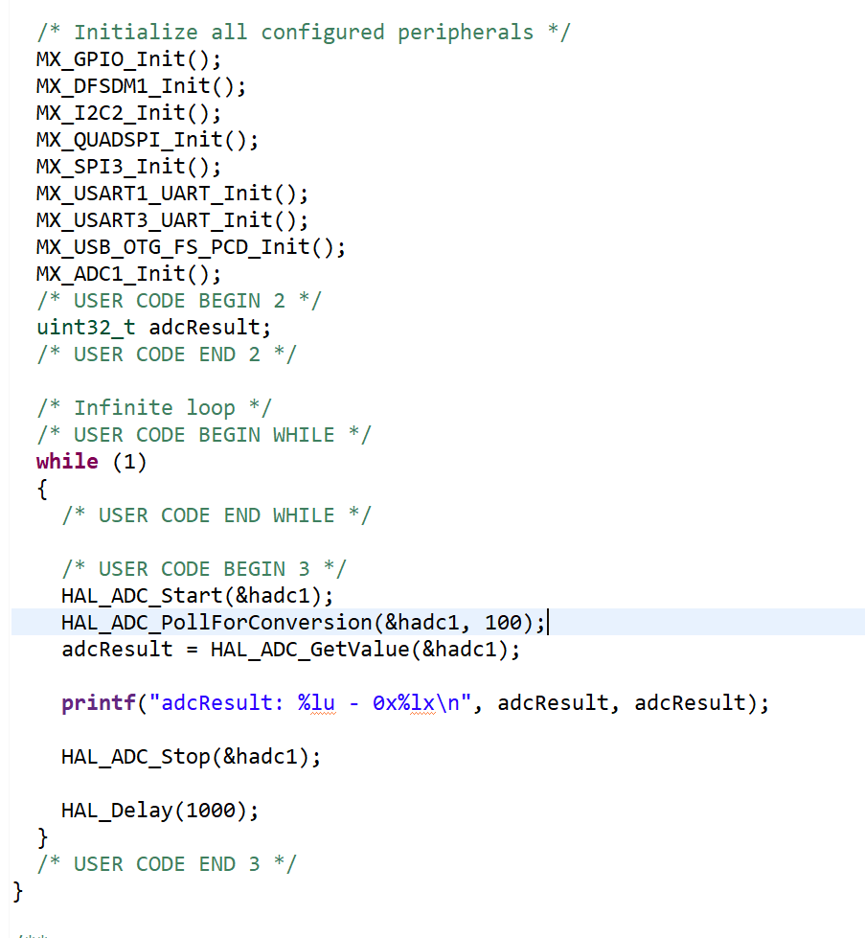
Step 12. Add code to main.c to read from ARD_A0

Slide 14
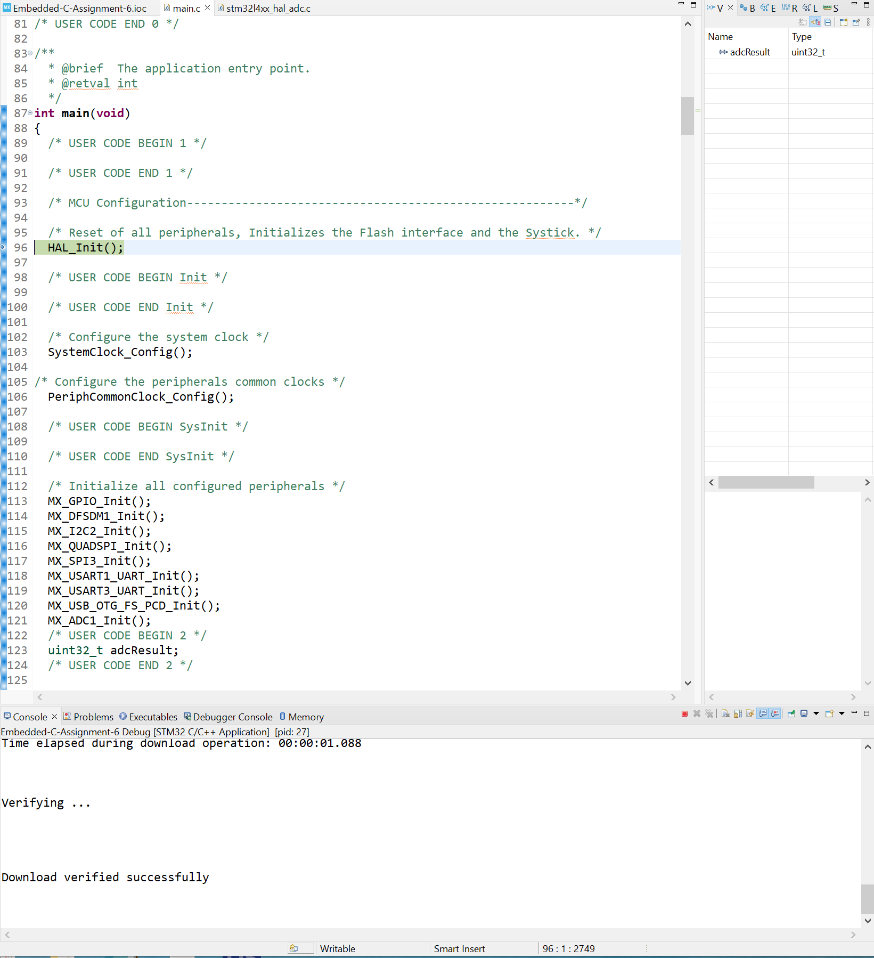
Step 13. Build project and run in debug mode

Slide 15
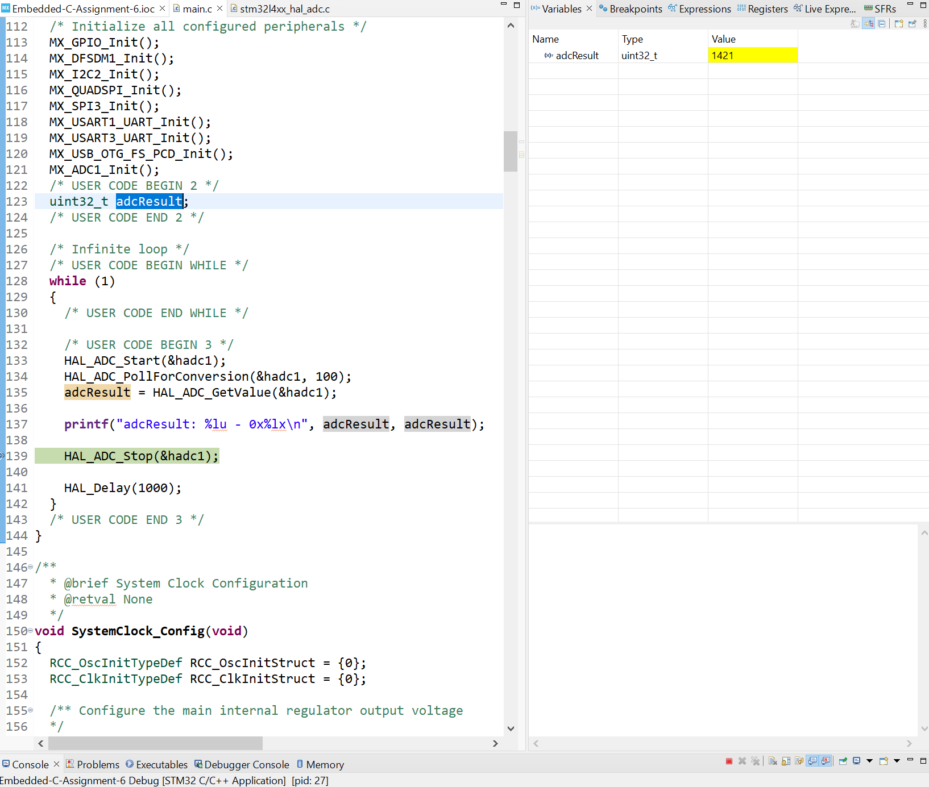
Step 14, Set the break point, then read the adcResult when nothing connected to ARD_A0. In my case adcResult = 916

Slide 16
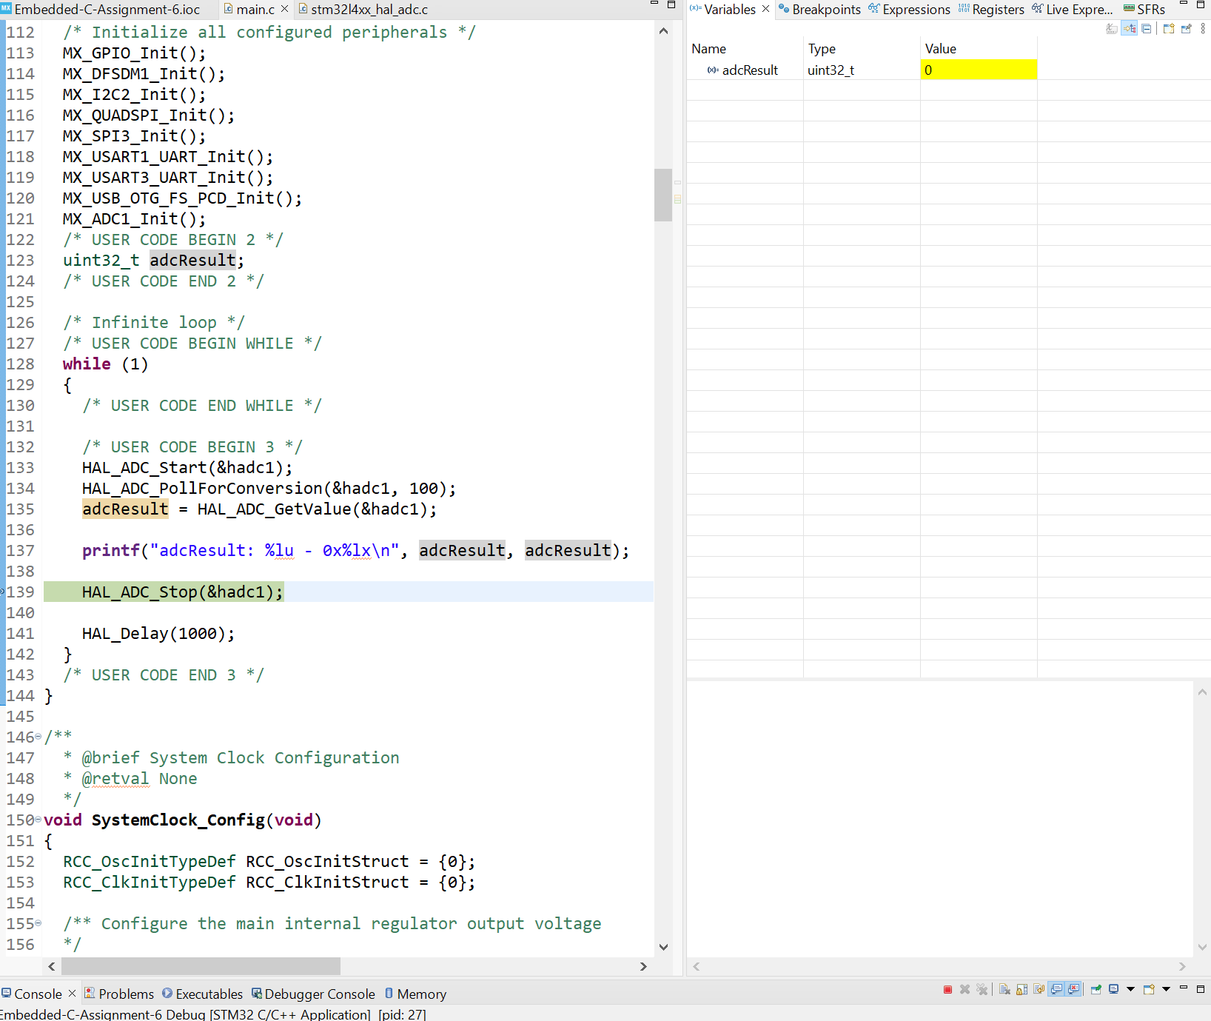
Step 15. Connect ADR_A0 to GND, then adcResult = 0

Slide 17
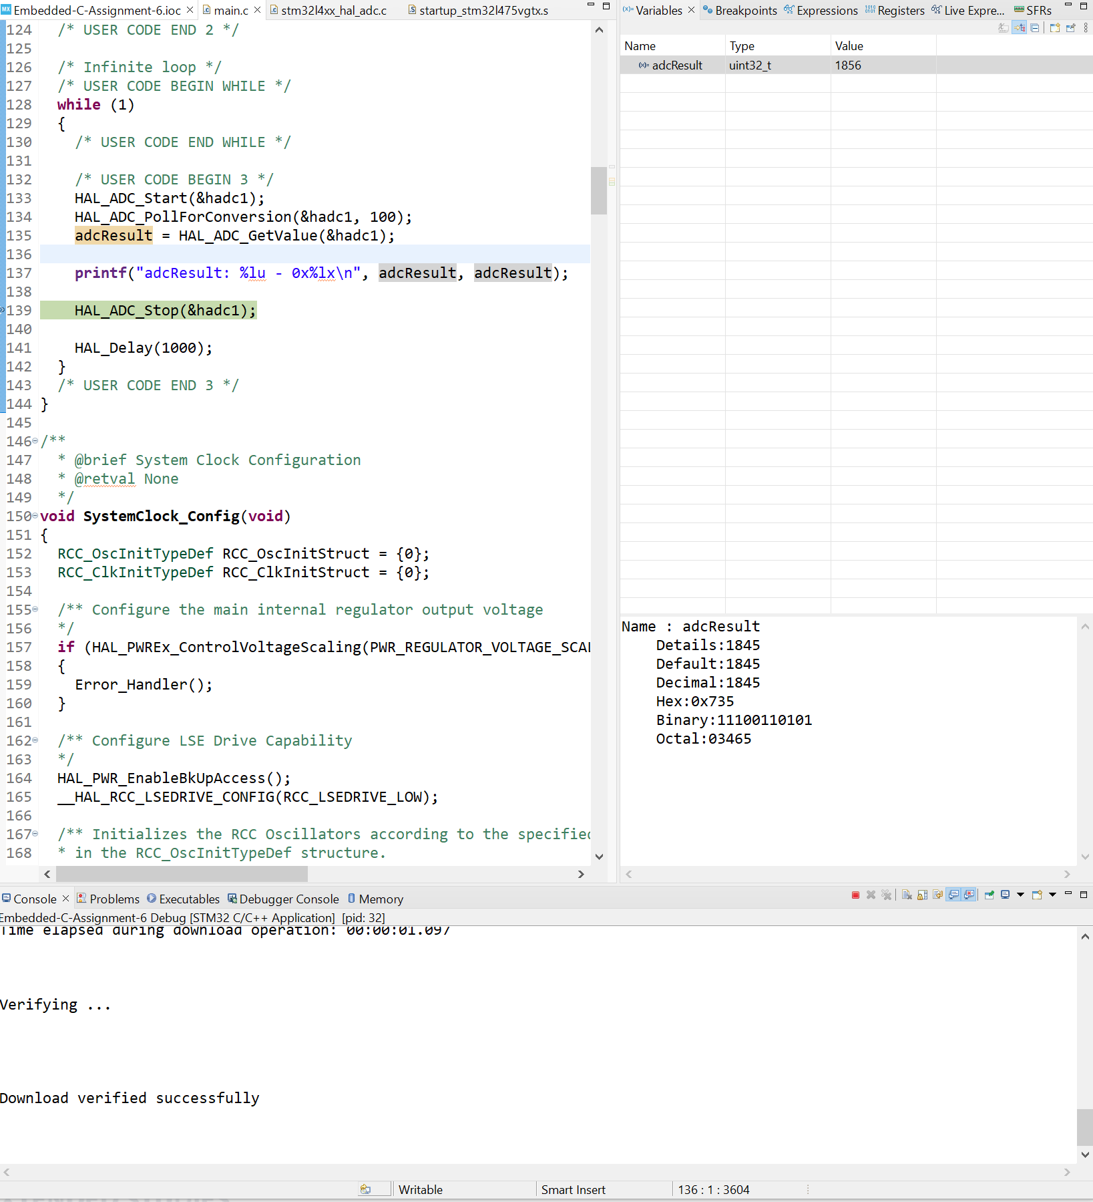
Step 16. Connect ADR_A0 to 1.5VDC. Then adcResult = 1856

